Slide 1
Chapter 1
Introduction to Macroeconomics

Slide 2
Chapter Outline
What Macroeconomics Is About
What Macroeconomists Do
Why Macroeconomists Disagree

Slide 3
What Macroeconomics Is About
Macroeconomics: the study of structure and performance of national economies and government policies that affect economic performance
Issues addressed by macroeconomists:
  Long-run economic growth
  Business cycles
  Unemployment
  Inflation
  The international economy
  Macroeconomic policy
Aggregation: from microeconomics to macroeconomics

Slide 4
What Macroeconomics Is About
Long-run economic growth
  Figure 1.1: Output of United States since 1869

Slide 5
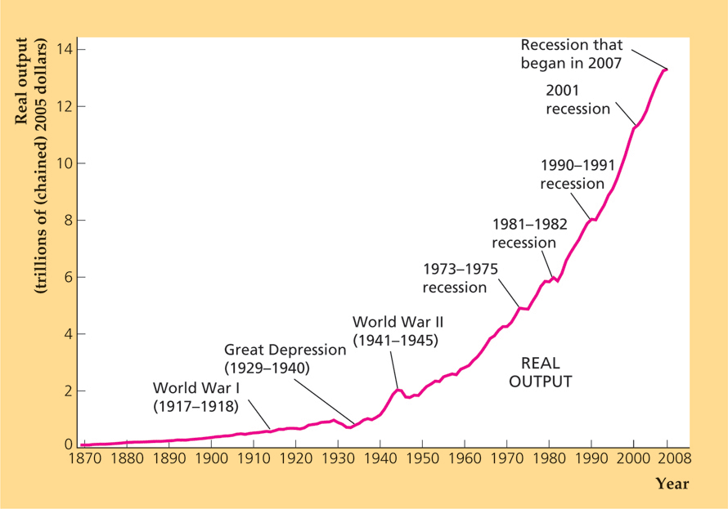
Figure 1.1 Output of the U.S. economy, 1869-2008
Sources: Real GNP 1869–1928 from Christina D. Romer, “The Prewar Business Cycle Reconsidered: New Estimates of Gross National Product, 1869–1908,” Journal of Political Economy, 97, 1 (February 1989), pp. 22–23; real GDP 1929 onward from FRED database, Federal Reserve Bank of St. Louis, research.stlouisfed.org/fred2/series/GDPCA. Data from Romer were rescaled to 2005 prices.

Slide 6
What Macroeconomics Is About
Long-run economic growth
  Figure 1.1: Output of United States since 1869
  Note decline in output in recessions; increase in output in some wars
  Two main sources of growth
    Population growth
    Increases in average labor productivity

Slide 7
What Macroeconomics Is About
Average labor productivity
  Output produced per unit of labor input
  Figure 1.2 shows average labor productivity for United States since 1900

Slide 8
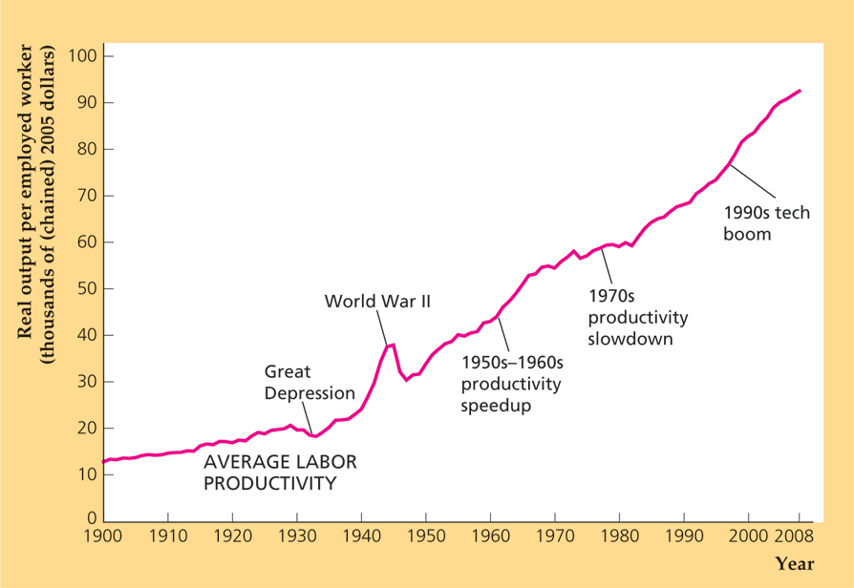
Figure 1.2 Average labor productivity in the United States, 1900-2008
Sources: Employment in thousands of workers 14 and older for 1900–1947 from Historical Statistics of the United States, Colonial Times to 1970, pp. 126–127; workers 16 and older for 1948 onward from FRED database, Federal Reserve Bank of St. Louis, research.stlouisfed.org/fred2/series/CE16OV. Average labor productivity is output divided by employment, where output is from Fig. 1.1.

Slide 9
What Macroeconomics Is About
Average labor productivity growth:
  About 2.5% per year from 1949 to 1973
  1.1% per year from 1973 to 1995
  1.7% per year from 1995 to 2008

Slide 10
What Macroeconomics Is About
Business cycles
  Business cycle: Short-run contractions and expansions in economic activity
  Downward phase is called a recession

Slide 11
What Macroeconomics Is About
Unemployment
  Unemployment: the number of people who are available for work and actively seeking work but cannot find jobs
  U.S. experience shown in Fig. 1.3
  Recessions cause unemployment rate to rise

Slide 12
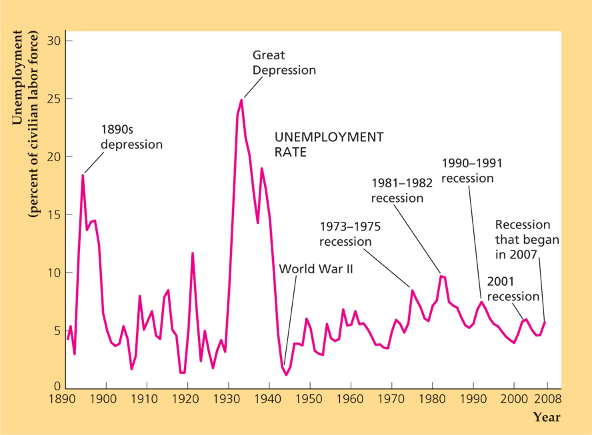
Figure 1.3 The U.S. unemployment rate, 1890-2008
Sources: Civilian unemployment rate (people aged 14 and older until 1947, aged 16 and older after 1947) for 1890–1947 from Historical Statistics of the United States, Colonial Times to 1970, p. 135; for 1948 onward from FRED database Federal Reserve Bank of St. Louis, research.stlouisfed.org/fred2/series/UNRATE.

Slide 13
What Macroeconomics Is About
Inflation
  U.S. experience shown in Fig. 1.4

Slide 14
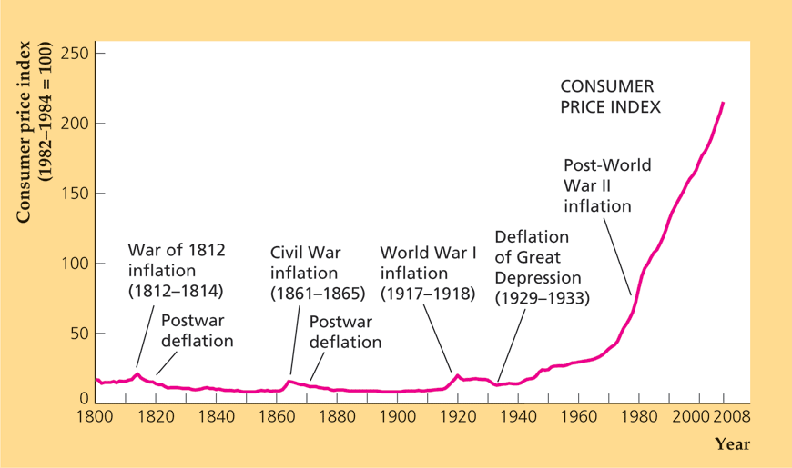
Figure 1.4 Consumer prices in the
United States, 1800-2008
Sources: Consumer price index, 1800–1946 (1967 = 100) from Historical Statistics of the United States, Colonial Times to 1970, pp. 210–211; 1947 onward (1982–1984 = 100) from FRED database, Federal Reserve Bank of St. Louis, research. stlouisfed.org/fred2/series/CPIAUCSL. Data prior to 1971 were rescaled to a base with1982–1984 = 100.

Slide 15
What Macroeconomics Is About
Inflation
  Deflation: when prices of most goods and services decline
  Inflation rate: the percentage increase in the level of prices
  Hyperinflation: an extremely high rate of inflation

Slide 16
What Macroeconomics Is About
The international economy
  Open vs. closed economies
    Open economy: an economy that has extensive trading and financial relationships with other national economies
    Closed economy: an economy that does not interact economically with the rest of the world
  Trade imbalances
    U.S. experience shown in Fig. 1.5
    Trade surplus: exports exceed imports
    Trade deficit: imports exceed exports

Slide 17
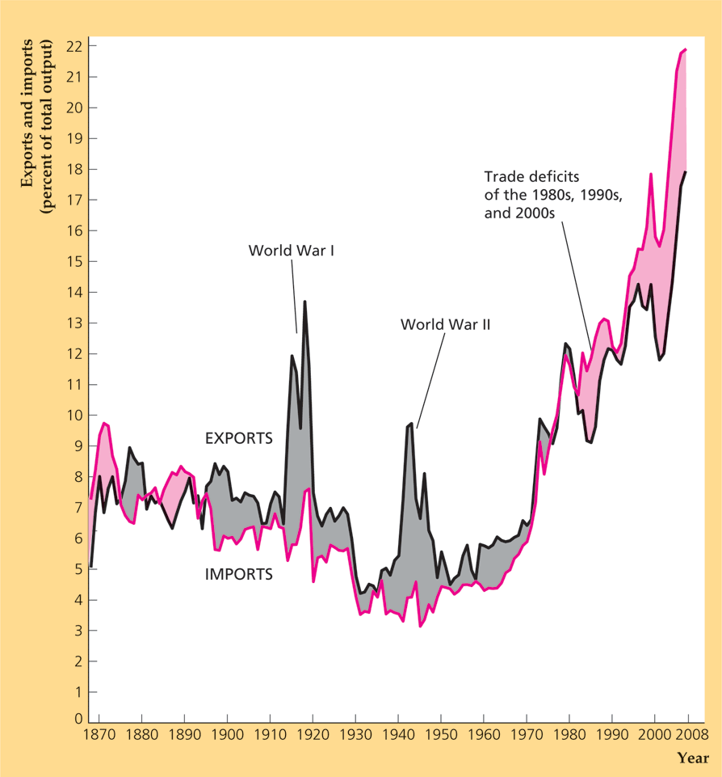
Figure 1.5 U.S. exports and imports,
1869-2008
Sources: Imports and exports of goods and services: 1869–1959 from Historical Statistics of the United States, Colonial Times to 1970, pp. 864–865; 1960 onward from FRED database, Federal Reserve Bank of St. Louis, research.stlouisfed.org/fred2/series/BOPX and BOPM; output is from Fig. 1.1.

Slide 18
What Macroeconomics Is About
Macroeconomic Policy
  Fiscal policy: government spending and taxation
    Effects of changes in federal budget
    U.S. experience in Fig. 1.6
    Relation to trade deficit?
  Monetary policy: growth of money supply; determined by central bank; the Fed in U.S.

Slide 19
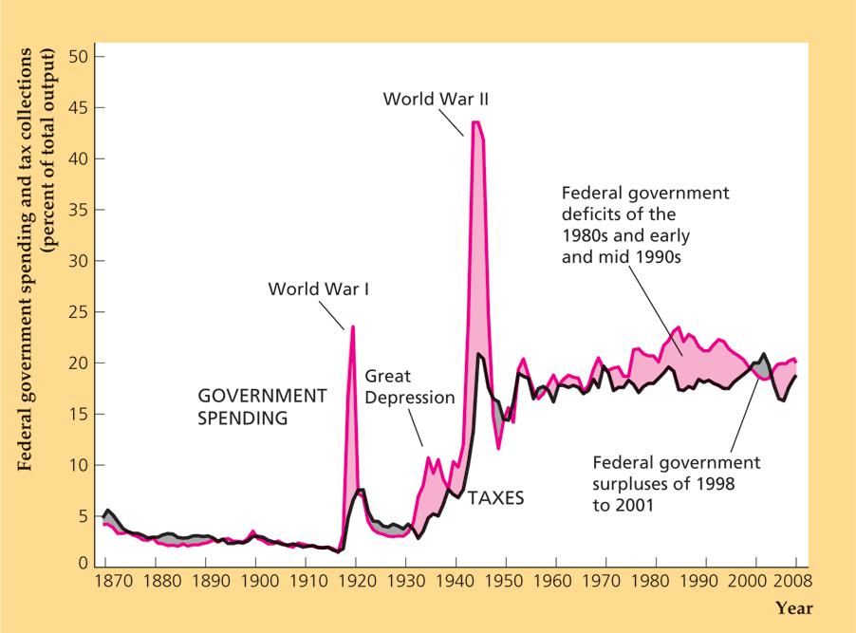
Figure 1.6 U.S. Federal government
spending and tax collections, 1869-2008
Sources: Federal spending and receipts: 1869–1929 from Historical Statistics of the United States, Colonial Times to 1970, p. 1104; 1930 onward from Historical Tables, Budget of the U.S. Government, Table 1.2; Output, 1869–1928 (GNP) from Christina D. Romer, “The Prewar Business Cycle Reconsidered: New Estimates of Gross National Product, 1869–1908,” Journal of Political Economy, 97, 1 (February 1989), pp. 22–23; 1929 onward (GDP) from BEA Web site, www.bea.gov.

Slide 20
What Macroeconomics Is About
Aggregation
  Aggregation: summing individual economic variables to obtain economywide totals
  Distinguishes microeconomics (disaggregated) from macroeconomics (aggregated)

Slide 21
What Macroeconomists Do
Macroeconomic forecasting
  Relatively few economists make forecasts
  Forecasting is very difficult
Macroeconomic analysis
  Private and public sector economists—analyze current conditions
  Does having many economists ensure good macroeconomic policies? No, since politicians, not economists, make major decisions

Slide 22
What Macroeconomists Do
Macroeconomic research
  Goal: to make general statements about how the economy works
  Theoretical and empirical research are necessary for forecasting and economic analysis
  Economic theory: a set of ideas about the economy, organized in a logical framework
  Economic model: a simplified description of some aspect of the economy
  Usefulness of economic theory or models depends on reasonableness of assumptions, possibility of being applied to real problems, empirically testable implications, theoretical results consistent with real-world data

Slide 23
What Macroeconomists Do
In Touch with Data and Research: Developing and Testing an Economic Theory
  Step 1: State the research question
  Step 2: Make provisional assumptions
  Step 3: Work out the implications of the theory
  Step 4: Conduct an empirical analysis to compare the implications of the theory with the data
  Step 5: Evaluate the results of your comparisons

Slide 24
What Macroeconomists Do
Data development—very important for making data more useful

Slide 25
Why Macroeconomists Disagree
Positive vs. normative analysis
  Positive analysis: examines the economic consequences of a policy
  Normative analysis: determines whether a policy should be used

Slide 26
Why Macroeconomists Disagree
Classicals vs. Keynesians
  The classical approach
    The economy works well on its own
    The “invisible hand”: the idea that if there are free markets and individuals conduct their economic affairs in their own best interests, the overall economy will work well
    Wages and prices adjust rapidly to get to equilibrium
      Equilibrium: a situation in which the quantities demanded and supplied are equal
      Changes in wages and prices are signals that coordinate people’s actions
    Result: Government should have only a limited role in the economy

Slide 27
Why Macroeconomists Disagree
Classicals vs. Keynesians
  The Keynesian approach
    The Great Depression: Classical theory failed because high unemployment was persistent
    Keynes: Persistent unemployment occurs because wages and prices adjust slowly, so markets remain out of equilibrium for long periods
    Conclusion: Government should intervene to restore full employment

Slide 28
Why Macroeconomists Disagree
Classicals vs. Keynesians
  The evolution of the classical-Keynesian debate
    Keynesians dominated from WWII to 1970
    Stagflation led to a classical comeback in the 1970s
    Last 30 years: excellent research with both approaches

Slide 29
Why Macroeconomists Disagree
A unified approach to macroeconomics
  Textbook uses a single model to present both classical and Keynesian ideas
  Three markets: goods, assets, labor
  Model starts with microfoundations: individual behavior
  Long run: wages and prices are perfectly flexible
  Short run: Classical case—flexible wages and prices; Keynesian case—wages and prices are slow to adjust

